Slide 1

CSE- 104
Structured Programming Lab
Lab : 03 Arrays in C
Fahad Ahmed
Lecturer, Dept. of CSE
E-mail: fahadahmed@uap-bd.edu

Slide 2
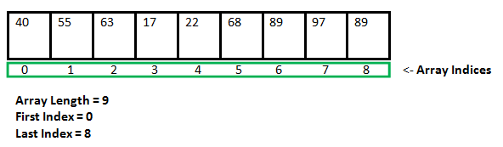
Arrays in C
An array in C or C++ is a collection of items stored at contiguous memory locations and elements can be accessed randomly using indices of an array.
They are used to store similar type of elements as in the data type must be the same for all elements.
They can be used to store collection of primitive data types such as int, float, double, char, etc of any particular type.

Slide 3
Arrays in C
How to declare an array?
dataType arrayName[arraySize];
For example,
float mark[5];
Here, we declared an array, mark, of floating-point type.
And its size is 5. Meaning, it can hold 5 floating-point values.
** It's important to note that the size and type of an array cannot be changed once it is declared.

Slide 4
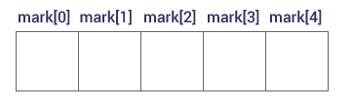
Arrays in C
Access Array Elements
You can access elements of an array by indices.
Suppose you declared an array mark as above.
The first element is mark[0], the second element is mark[1] and so on.

Slide 5
Arrays in C
Access Array Elements
You can access elements of an array by indices.
Suppose you declared an array mark as above.
The first element is mark[0], the second element is mark[1] and so on.

Slide 6
Arrays in C
Arrays have 0 as the first index, not 1. In this example, mark[0] is the first element.
If the size of an array is n, to access the last element, the n-1 index is used. In this example, mark[4]
Suppose the starting address of mark[0] is 2120d. Then, the address of the mark[1] will be 2124d. Similarly, the address of mark[2] will be 2128d and so on.
This is because the size of a float is 4 bytes.

Slide 7
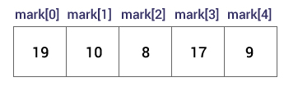
Arrays in C
How to initialize an array?
It is possible to initialize an array during declaration. For example,
int mark[5] = {19, 10, 8, 17, 9};
You can also initialize an array like this.
int mark[] = {19, 10, 8, 17, 9};
Here, we haven't specified the size. However, the compiler knows its size is 5 as we are initializing it with 5 elements.

Slide 8
Arrays in C
mark[0] is equal to 19
mark[1] is equal to 10
mark[2] is equal to 8
mark[3] is equal to 17
mark[4] is equal to 9

Slide 9
Arrays in C
Change Value of Array elements
int mark[5] = {19, 10, 8, 17, 9};
element to -1 mark[2] = -1;
element to 0 mark[4] = 0;

Slide 10
Arrays in C
Input and Output Array Elements
Here's how you can take input from the user and store it in an array element.
// take input and store it in the 3rd element ​
scanf("%d", &mark[2]);
// take input and store it in the ith element
scanf("%d", &mark[i-1]);
// print the third element of the array
printf("%d", mark[2]);
// print ith element of the array
printf("%d", mark[i-1]);

Slide 11
Exercise
2 | 7 | gg | gg | gg
Write a program to take integers 5 values from the user and store them in an array and print the elements from array.

Slide 12
Solution
#include <stdio.h>
int main()
{
int values[5];
printf("Enter 5 integers: ");
// taking input and storing it in an array
for(int i = 0; i < 5; ++i)
scanf("%d", &values[i]);
printf("Displaying integers: ");
// printing elements of an array
for(int i = 0; i < 5; ++i)
{
printf("%d\n", values[i]);
}
return 0;
}

Slide 13
Exercise
Write a C program to print all negative elements in array
Input / Output
Enter size of the array : 10
Enter elements in array : -1 -10 100 5 61 -2 -23 8 -90 51
All negative elements in array are : -1 -10 -2 -23 -90

Slide 14
Exercise
Write a program to find the average of n numbers using arrays

Slide 15
Solution
#include <stdio.h>
int main()
{
int marks[10], i, n, sum = 0;
float average;
printf("Enter number of elements: ");
scanf("%d", &n);
for(i=0; i<n; ++i)
{
printf("Enter number%d: ",i+1);
scanf("%d", &marks[i]);
// adding integers entered by the user to the sum variable
sum += marks[i];
}
average = sum/n;
printf("Average = %f", average);
return 0;
}

Slide 16
Exercise
Program to copy array elements to another array
Input/Output
Enter the size of the array : 10
Enter elements of source array : 10 20 30 40 50 60 70 80 90 100
Elements of source array are : 10 20 30 40 50 60 70 80 90 100
Elements of dest array are : 10 20 30 40 50 60 70 80 90 100

Slide 17
Exercise
C program to search element in an array
Input / Output
Input
Input size of array: 10
Input elements in array: 10, 12, 20, 25, 13, 10, 9, 40, 60, 5
Output
Element to search is: 25
Element found at index 3

Slide 18
Exercise
C program to sort array in ascending or descending order. (bubble sort)
Input / Output
Input
Input size of array: 10
Input array elements: 20, 2, 10, 6, 52, 31, 0, 45, 79, 40
Output
Array sorted in ascending order: 0, 2, 6, 10, 20, 31, 40, 45, 52, 79

Slide 19
Exercise
Write a program in C to count a total number of duplicate elements in an array
Input/Output
input the number of elements to be stored in the array :3 Input 3 elements in the array : element - 0 : 5 element - 1 : 1 element - 2 : 1 Expected Output : Total number of duplicate elements found in the array is : 1

Slide 20
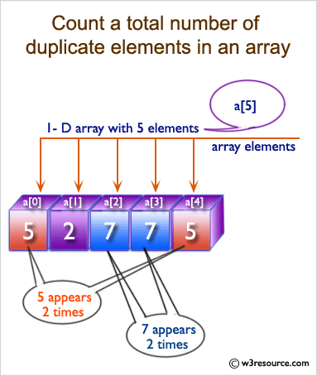
Exercise

Slide 21
Exercise Home Task
Write a program in C to print all unique elements in an array.
Input/Output
Input the number of elements to be stored in the array: 4 Input 4 elements in the array : element - 0 : 3 element - 1 : 2 element - 2 : 2 element - 3 : 5 Expected Output : The unique elements found in the array are: 3 5

Slide 22
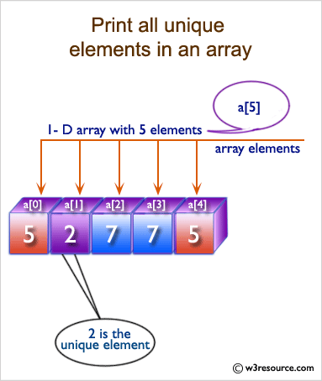
Exercise

Slide 23
Multidimensional Arrays
In C programming, you can create an array of arrays.
These arrays are known as multidimensional arrays.
For example,
int arr[3][4];
Here, x is a two-dimensional (2d) array. The array can hold 12 elements. You can think the array as a table with 3 rows and each row has 4 columns.

Slide 24
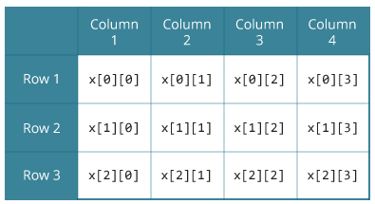
Multidimensional Arrays
int x[3][4];
Similarly, you can declare a three-dimensional (3d) array. For example,
float y[2][4][3];

Slide 25
Multidimensional Arrays
Initialization of a 2d array
Different ways to initialize two-dimensional array
int c[2][3] = { {1, 3, 0}, {-1, 5, 9} };
int c[ ][3] = { {1, 3, 0}, {-1, 5, 9} };
int c[2][3] = { 1, 3, 0, -1, 5, 9 };

Slide 26
Multidimensional Arrays Example
Write a program to find the sum of two matrices of order 2*2 [row=2, column=2]

Slide 27
Multidimensional Arrays Example
Task
write a c program addition of two matrix

Slide 28
Exercise
C program to insert element in array at given position.
Input
Input array elements: 10, 20, 30, 40, 50
Input element to insert: 25
Input position where to insert: 2
Output
Elements of array are: 10, 20, 25, 30, 40, 50

Slide 29
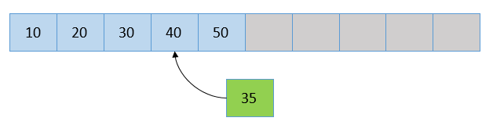
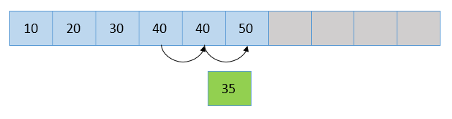
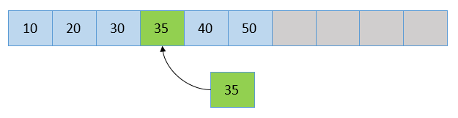
Exercise
C program to insert element in array at given position.
N=4
Pos=3

Slide 30
Exercise
Write a C program to delete element from array at specified position.
Input
Input array elements: 10 20 30 40 50
Input position to delete: 2
Output
Array elements: 10, 30, 40, 50

Slide 31
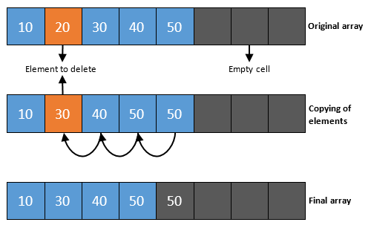
Exercise
Write a C program to delete element from array at specified position.

Slide 32
Home Task Exercise List
Write a program in C to count a total number of duplicate elements in an array
C program to insert element in array at given position
Write a C program to delete element from array at specified position.
C program to print all unique elements in array
C program count total duplicate elements in array
write a c program multiplication of two matrix

Slide 33

Thanks to All

